Slide 1
Hospital Management System

Slide 2
Objective:
Hospital Management system is a system used for enabling enrollment of patient, add physician, search for physician, update diagnosis details and view Patient history.
Enroll Patient – Hospital Administrators to register a Patient into the system. The administrator should have the details of the patient to be entered into the system.
Add Physician - Hospital Administrators to save the Physician details into the system.
Physician Search - Hospital Administrators to search for Physician based on specified search criteria
Patient Diagnosis Details - by Hospital Administrators to save the patients diagnosis details into the system.
View Patient History - Administrator wishes to view the patient case history details

Slide 3
Model View Controller Architecture
Model
View
Controller
Service
DAO
Database

Slide 4
Main-Process Architecture:
Admin sign in/Registration
Update/Maintain Patient Details
Update/Maintain Physician Details
Search Physician Details
Update Diagnosis Details
View Patient History
Logout

Slide 5
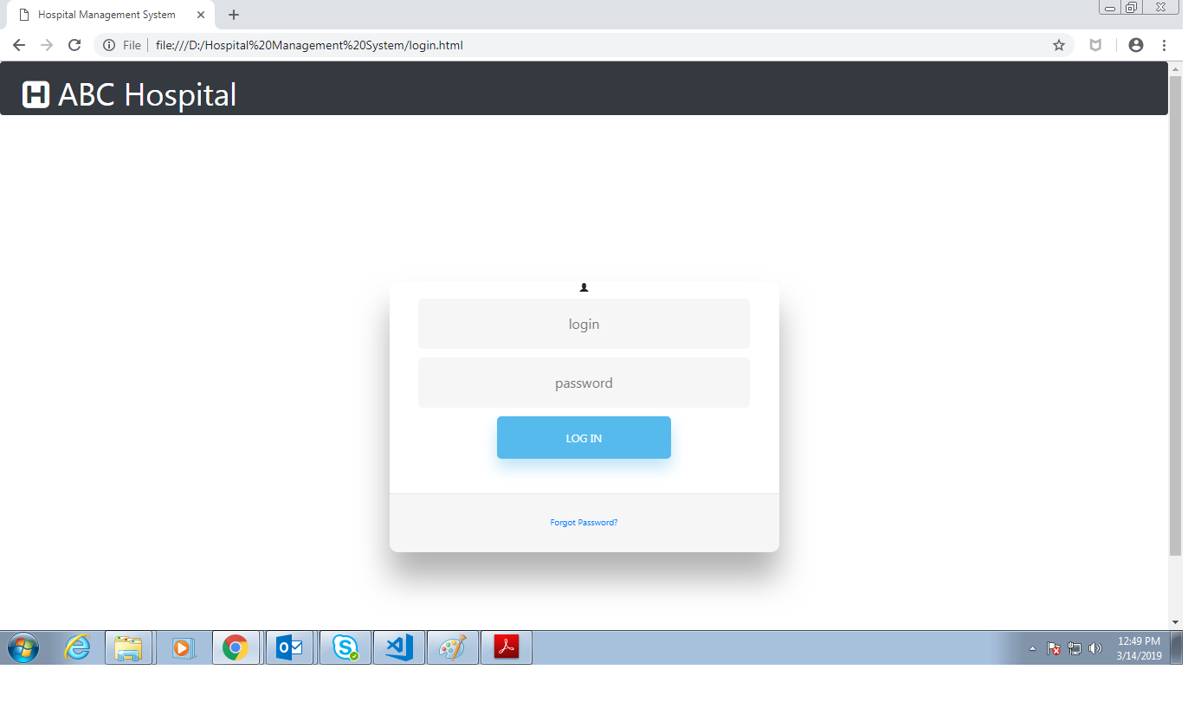
Output: Login page

Slide 6
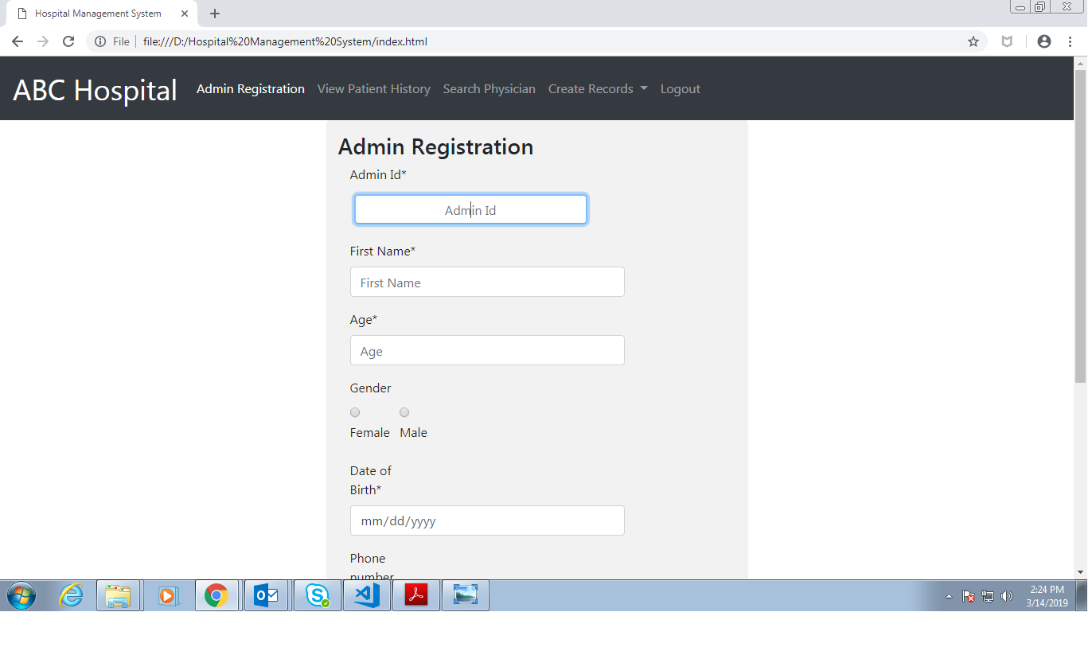
Output: Admin Registration Page

Slide 7
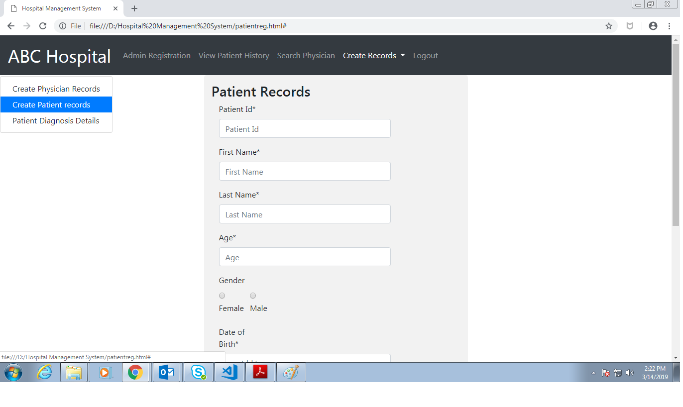
Output: Patient Records Page

Slide 8
Thank You

